Slide 1
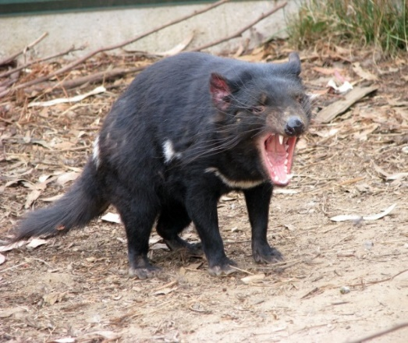
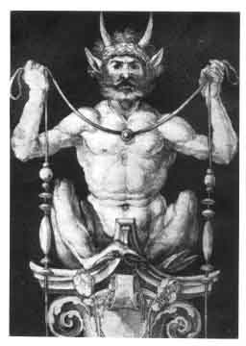
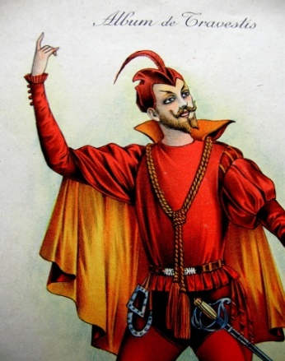
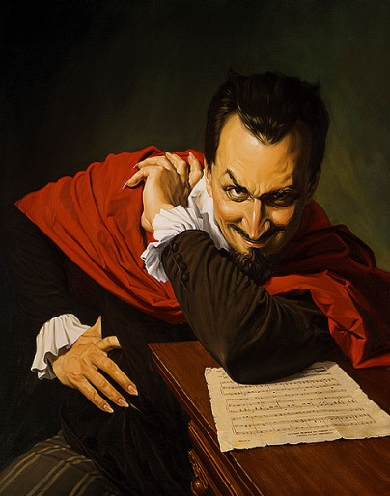
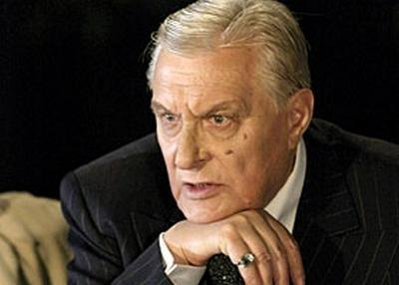
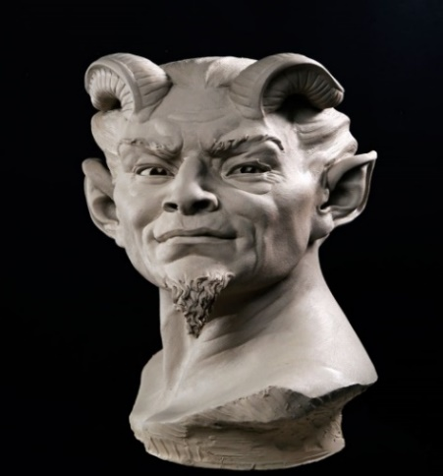
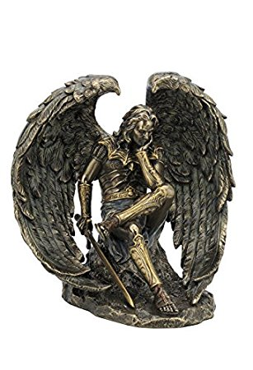
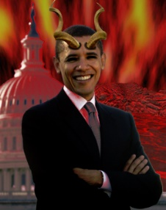
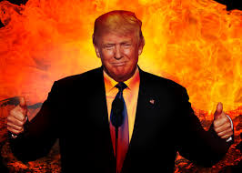
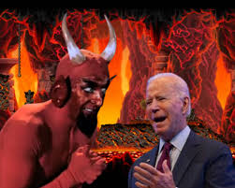

THE CHANGING FACE OF THE DEVIL
Fallen Angel
Beast; Monster
Traveling Scholar
Man of Wealth & Taste
Man of Power
Audio Berlioz, Dies Irae from Symphonie Fantastique

Slide 2
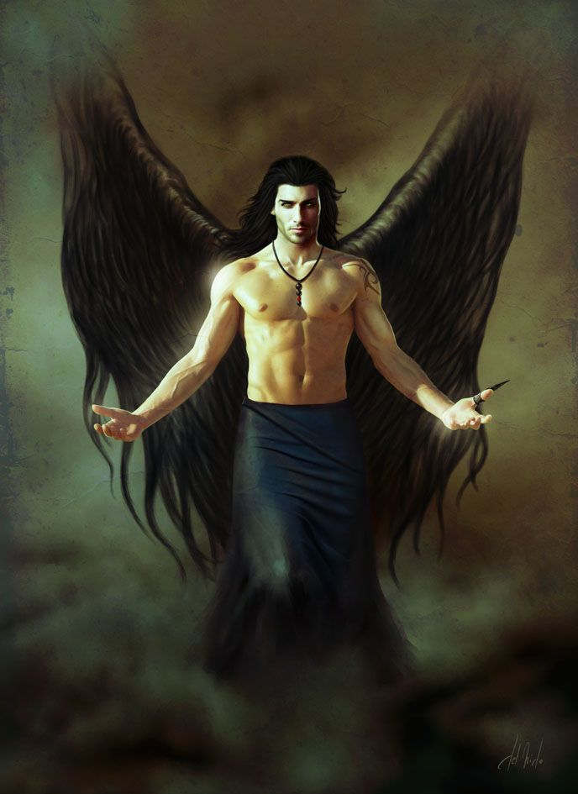
I. WHO WAS/IS THE DEVIL?
ORIGINAL [CHRISTIAN]IDENTITY:
LUCIFER, THE FALLEN ANGEL:
A METAPHYSICAL BEING.
SYMBOLIC IDENTITIES:
Head of a demonical church & army
The evil arm of God
The embodiment of Evil
The spirit or principal of negation
A literary character
A comedian, vaudevillian
The reality of evil in the world

Slide 3
II. HOW THE DEVIL CAME TO BE: Origin; Power; Relationship to God

Slide 4
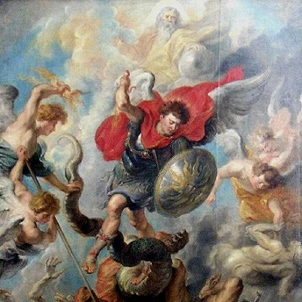
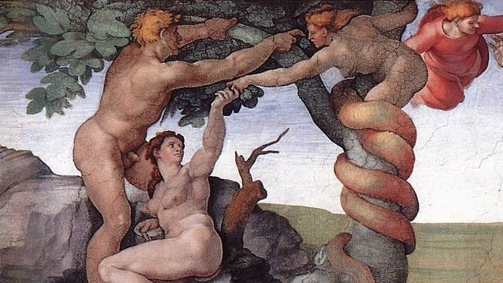
1./2. ORIGIN OF THE DEVIL IN CHRISTIANITY
When God created heaven, Lucifer was the highest angel but he betrayed his creator. Proud & envious, he wanted to be God and he hated humankind.
Lucifer led a rebellion against God, for which God threw Lucifer out of heaven and condemned him to wander the earth eternally. Out of revenge, Lucifer corrupted Adam and Eve; God made Lucifer the lord of “this world.”
Lucifer is the first cause of Evil - sin, despair and war. He assigns a demon for each vice; he and his demons can appear anywhere, in whatever form they choose. They are shapeshifters.
All sinners serve the devil.
THE EJECTION FROM HEAVEN
TEMPTATION OF ADAM & EVE

Slide 5
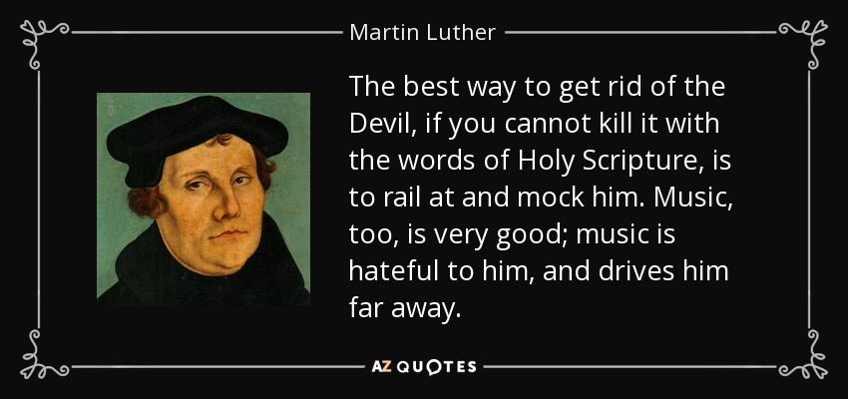
3. THE RELATIONSHIP OF THE DEVIL (EVIL) TO GOD (GOOD) IN REFORM CHRISTIANITY (LUTHERANISM)
The only valid bases for thought are faith and the bible.
God is absolutely omnipotent.
Everything is absolutely predestined.
“God incites the devil to evil, but he does not do evil himself.”
Therefore…
The devil is god’s tool. The devil would not exist if god had not created him; the devil would not be evil if god had not willed him to be evil; the devil could not work evil if god did not allow him to do so.

Slide 6
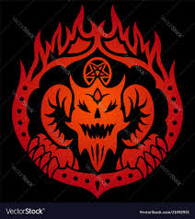
III. THE EVOLUTION OF THE DEVIL, a.k.a MEPHISTOPHELES
From person to personality
From reality to symbol

Slide 7
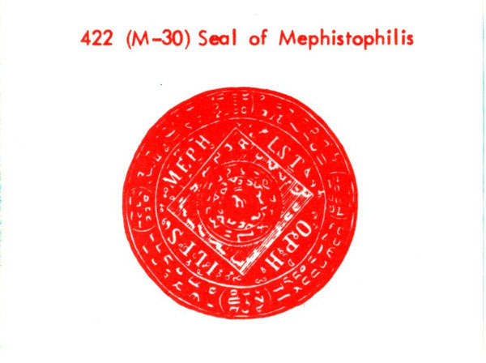
1.ORIGIN OF THE NAME MEPHISTOPHILES, FIRST APPEARING IN THE GERMAN FAUSTBOOK, 1587
Not a traditional Judeo-Christian
or folkloric name.
The derivation remains
uncertain, but the chief
elements are, FROM GREEK:
me= not
phos = light;
filos=lover.
“NOT A LOVER OF LIGHT.”

Slide 8
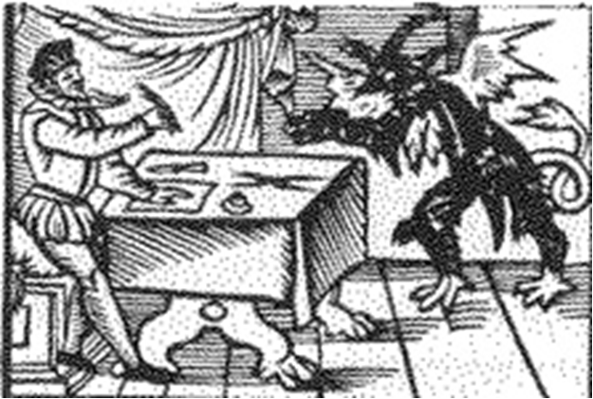
2. IN THE FAUSTBOOK, THE DEVIL IS A METAPHYSICAL BEING WHO EXISTS.

Slide 9
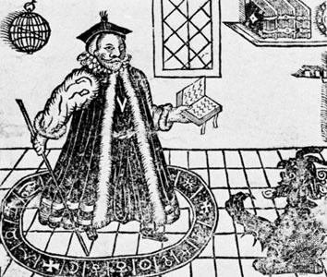
3. In Marlowe’s “Dr. Faustus” the devil is so ugly that Faustus commands him to change his shape and return as a friar.
For the rest of the play, the devil appears in human form and has human characteristics .
Faustus’ devil is called Mephistopheles. He is a soldier in Lucifer’s army and can do nothing without Lucifer’s permission.
Doctor Faustus conjuring the Devil
Woodcut from the 1620 edition of Marlowe’s Doctor Faustus

Slide 10
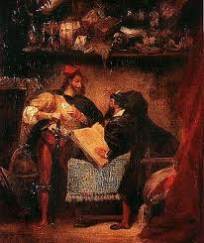
4. GOETHE’S ENLIGHTENMENT MEPHISTOPHELES
GOETHE CHANGED THE DEVIL FROM A THEOLOGICAL PERSON TO A LITERARY CHARACTER .
HE STRESSED THE EQUIVOCAL NATURE OF MEPHISTO: BOTH THE OPPONENT AND INSTRUMENT OF GOD.
MOST OF THE ARTISTIC, LITERARY, OPERATIC, AND CINEMATIC DEVILS AFTER GOETHE’S FAUST, ARE BASED ON HIS MEPHISTOPHELES.
Mephistopheles appears to Faust
by Eugene Delacroix, 1827/28

Slide 11
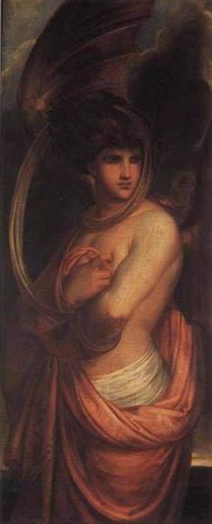
5. A 19th century artist’s rendition of the angel of evil; an ambivalent, almost decadent view of Satan.
Satan, The Angel of Evil
by Antoine Wiertz, 1839

Slide 12
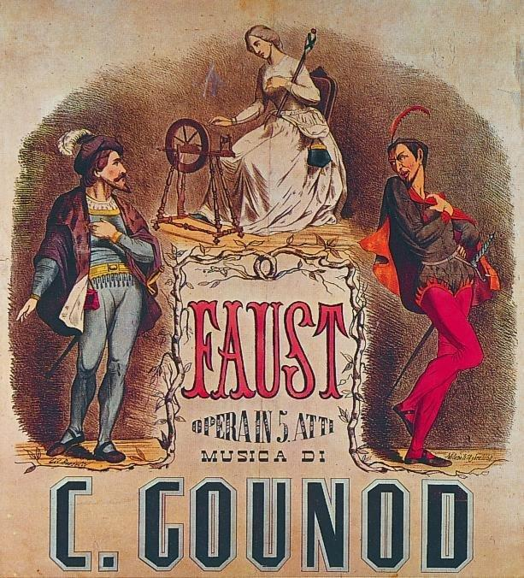
6. Gounod’s opera, Faust, shifts the focus of the story from the Faust/Mephistopheles duo to Margarita (Gretchen), the pure young girl Faust asks the Devil to get for him, and then seduces and abandons.
Goethe was the innovator who introduced a love story into the traditional tale of Faust.
Faust, opera by Charles Gounod, 1859

Slide 13
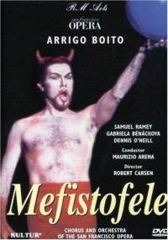
7. The other great 19th c opera based on Faust, is Arrigo Boito’s Mephistofeles. It highlights the character of Mephistopheles as the spirit of negation that represents one important side of Goethe’s Mephistopheles:
“I am the spirit that always negates.”
Mefistofele, opera by Arrigo Boito, 1867

Slide 14
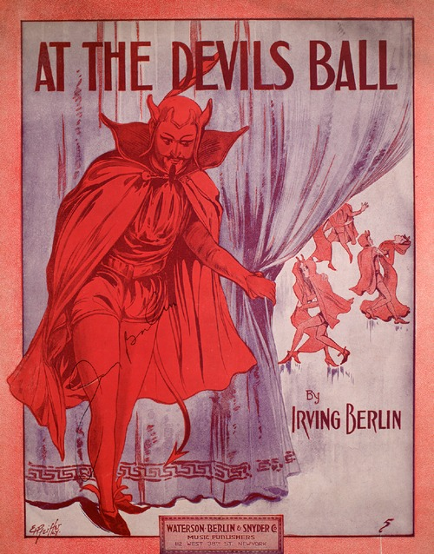
8. The ultimate trivialization of the devil in vaudeville – At the Devil’s Ball -- was a popular song by Irving Berlin written in 1913. Recall it when we come to the chapter “Satan’s Ball” in Master & Margarita.
Sheet music for popular American song by Irving Berlin, 1913

Slide 15
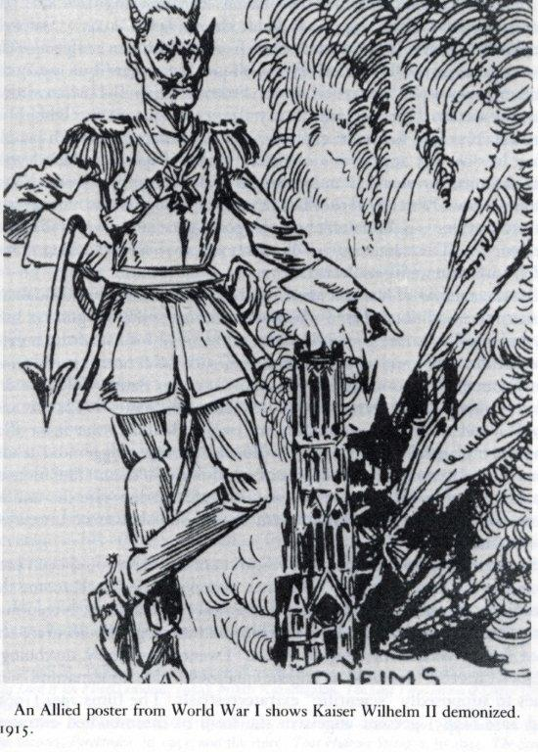
9. In the 20th century, “evil” men of power came more and more often to embody the devil, especially in the eyes of their opponents and victims.
Allied poster from World War I showing Kaiser Wilhelm II demonized, 1915

Slide 16
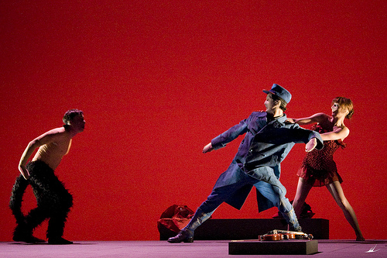
10. At the same time, 20th century artists in various media revived the earliest folk traditions of the devil.
“Devil’s Dance” from l’Histoire du Soldat by Igor Stravinsky, 1918

Slide 17
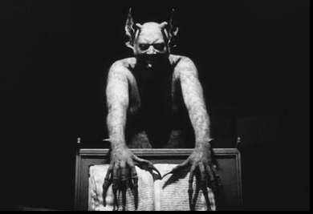
Film still from Häxan: Witchcraft Through the Ages, 1922

Slide 18
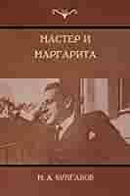
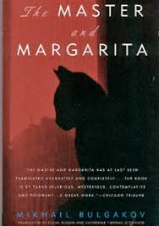
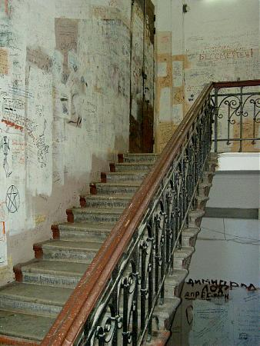
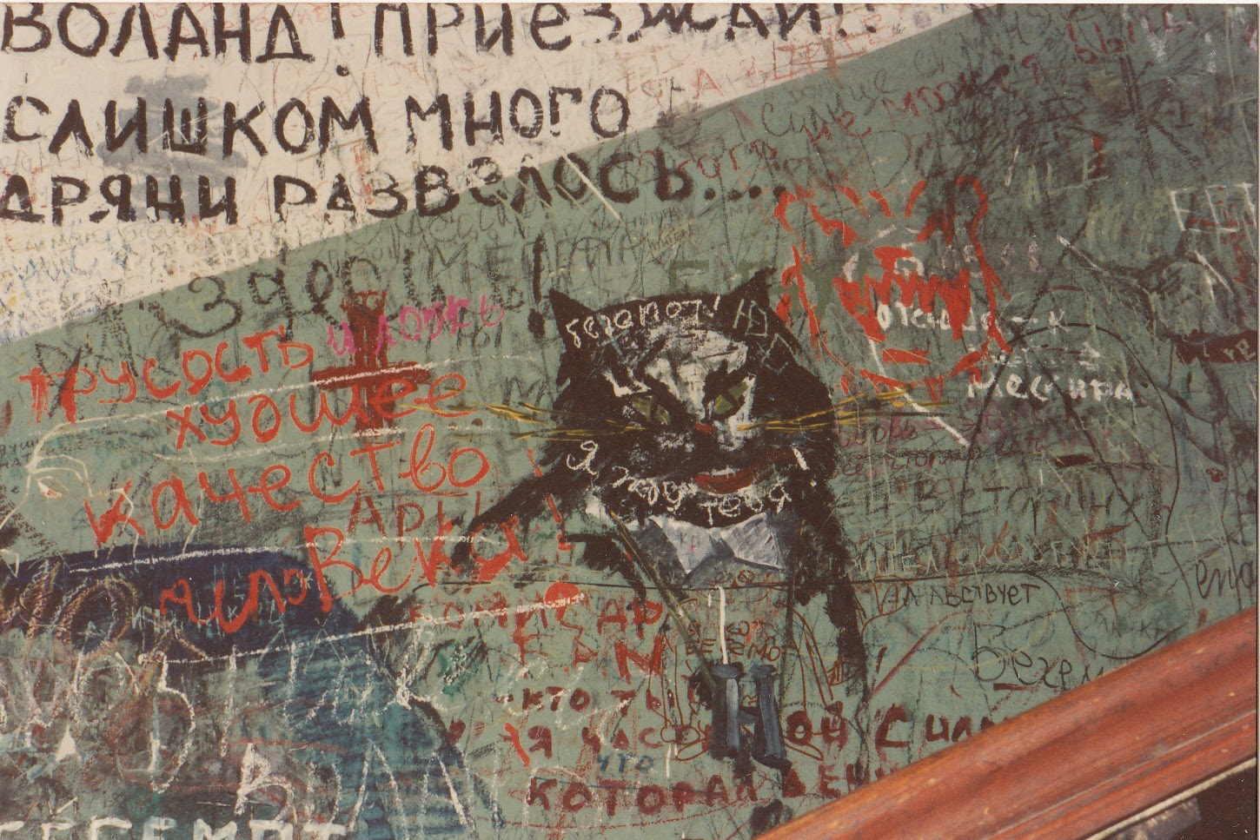
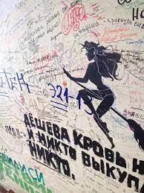
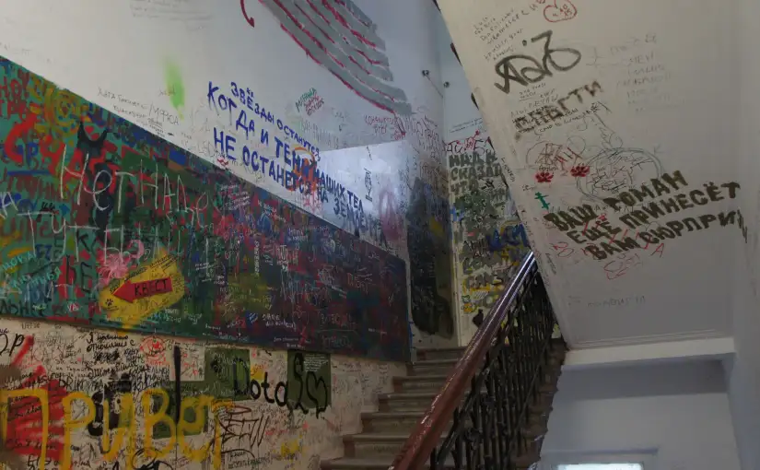
IV. MASTER AND MARGARITA
Finally, Mikhail Bulgakov’s Master and Margarita,
written from 1928-1940, incorporates the whole
tradition of the devil that began in the 16th century.
The novel has inspired operas, graphic novels, films,
and popular street art – graffiti decorating the
stairwells of a Moscow apartment building
where most of the novel takes place.
Bulgakov’s devil recovers his original status
as a metaphysical person who exists –
at least, in the multiple realities of the novel…

Slide 19
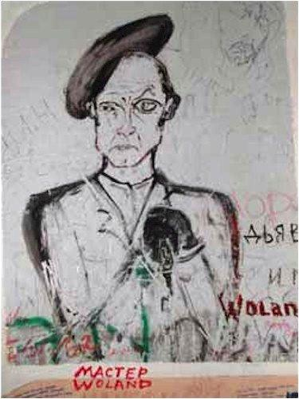
Woland in The Master and Margarita
Graffito from the stairwell of Apartment 50, 302B Sadovaya Street, Moscow

Slide 20
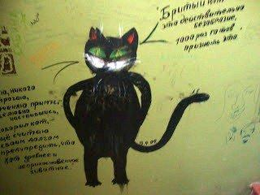
The demon-cat Behemoth in Master and Margarita
Graffito from the stairwell of Apartment 50, 302B Sadovaya Street, Moscow

Slide 21
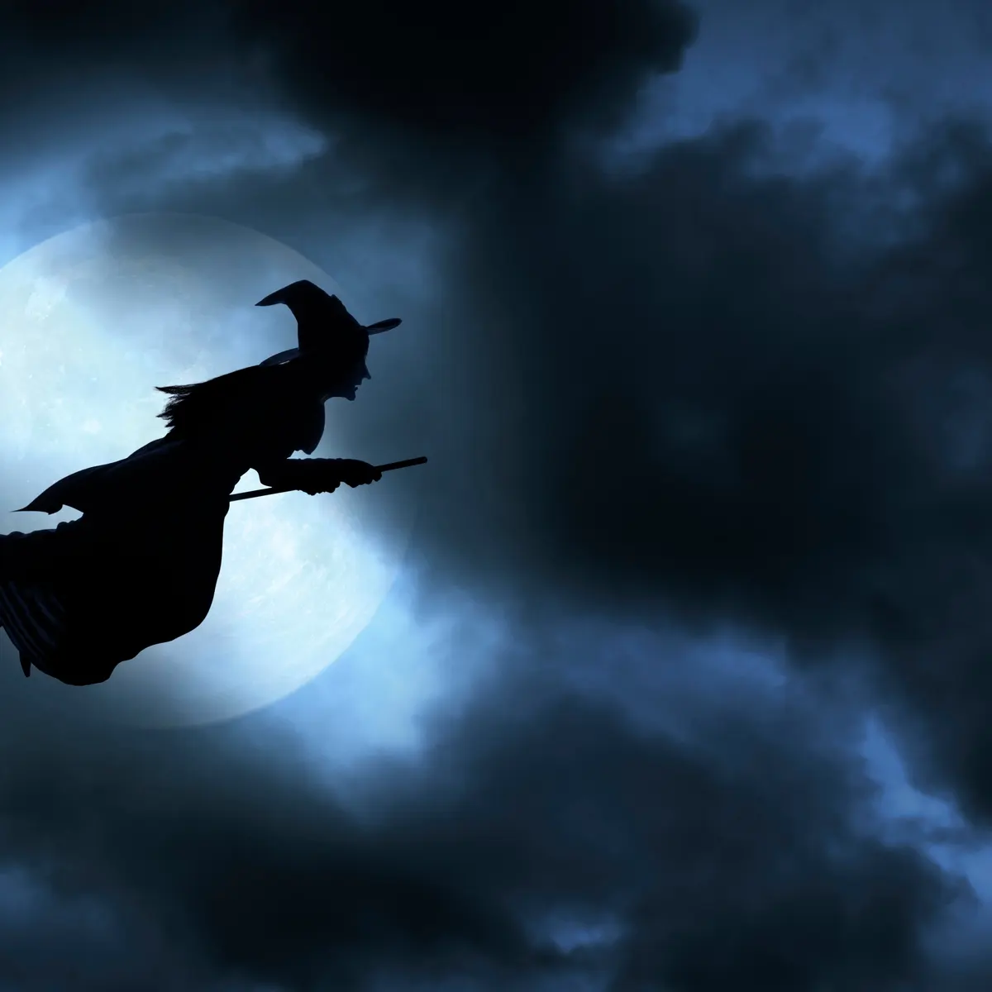
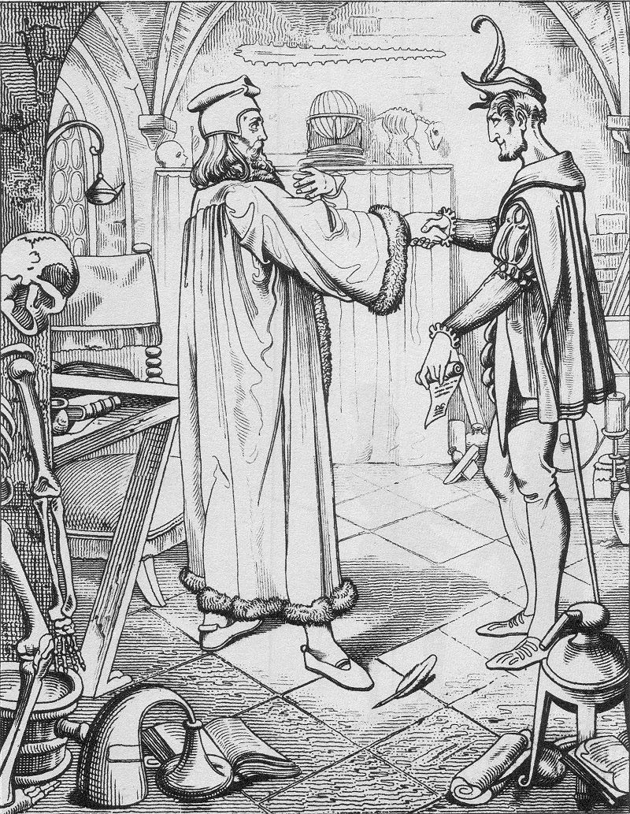
V. WHO WAS MOST LIKELY TO MAKE A PACT WITH THE DEVIL?
1. WITCHES 2. LEARNED MEN

Slide 22
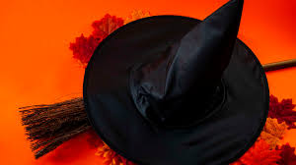
1. WITCHES

Slide 23
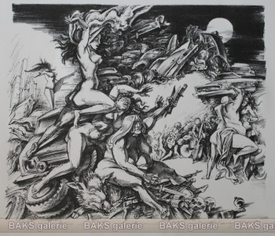
A.WITCHES WERE
WHAT HARM DID THEY DO?
1. RENDERED PEOPLE IMPOTENT OR STERILE;
2. BLIGHTED CROPS; CAUSED DISEASES; DRIED UP CATTLE;
3. CAUSED DEMONIC POSSESSION, MENTAL ILLNESS;
4. RENOUNCED CHRIST AND WORSHIPPED THE DEVIL;
5. MET AT NIGHT, FLEW TO THEIR “SABBAT” ON BROOMS, FENCES, OR ANIMALS, OR SIMPLY LEVITATED THROUGH THE AIR;
HELD INCESTUOUS ORGIES;
KIDNAPPED AND SACRIFICED CHRISTIAN BABIES…
PEOPLE WHO HAD MADE A PACT WITH THE DEVIL: IN RETURN FOR THEIR SERVICE, SATAN REWARDED THEM WITH MAGICAL POWERS, WHICH THEY USED FOR EVIL PURPOSES.

Slide 24
B. THE WITCH CRAZE
“Witches were to be found all over Europe, in every neighborhood, all linked in one great conspiracy under the generalship of Satan against the Christian community. Such a conspiracy never existed, yet papal pronouncements, Catholic councils, Protestant synods, inquisitorial tribunals, secular courts, and leading scholars all repeatedly proclaimed its reality.”
(Russell, The Devil in the Modern World, p 28.)

Slide 25

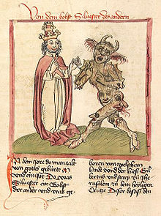
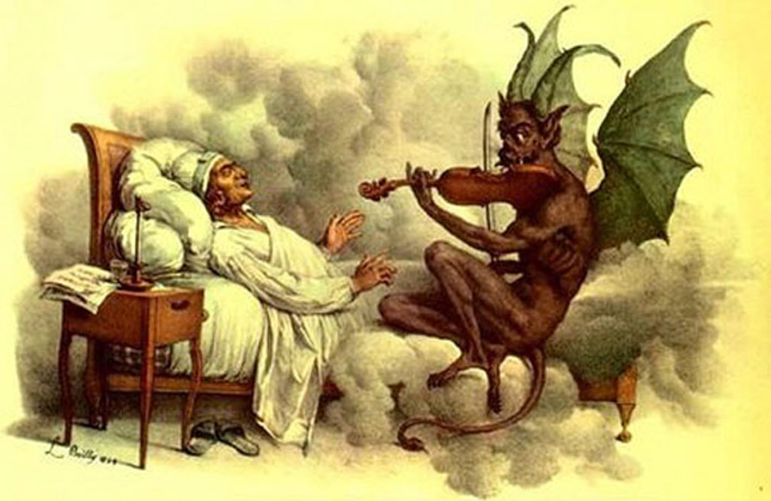
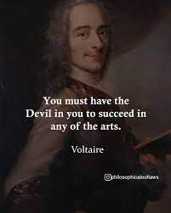
2. HOW LEARNED MEN CAME TO BE ASSOCIATED WITH THE DEVIL
1.At some point, learned Christians rationalized that
a. Satan might have his own Church, priests, ceremonies and his mass;
b. They themselves could be priests of Satan, who would give them what they were forbidden to request from God.
2. They turned to sorcery and necromancy
a. Sorcerers cast “sors” or spells over those to whom they wished evil; they could also evoke the Devil or subordinate demons;
b. Necromancers could call up apparitions of the dead.
3. The earlier one goes back in time, the more revered sorcerers and magicians were.

Slide 26
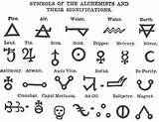
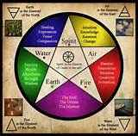
VI. MAGIC WORDS
ALCHEMY
ASTROLOGY
NECROMANCY
SOOTHSAYING
SORCERY

Slide 27
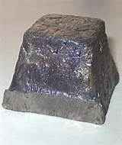
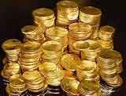
1. ALCHEMY Pb Au
A medieval chemical philosophy having as its aim the transmutation of base metals into gold, the discovery of the panacea, and the preparation of the elixir of longevity.

Slide 28
2. ASTROLOGY
THE STUDY OF THE POSITIONS AND ASPECTS OF HEAVENLY BODIES IN THE BELIEF THAT THEY HAVE AN INFLUENCE ON THE COURSE OF HUMAN AFFAIRS.

Slide 29
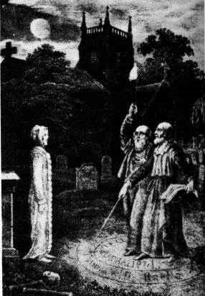
3. NECROMANCY
The practice of communicating with the spirits of the dead in order to predict the future. Black magic, sorcery.
From Greek: necromanteia, nekras (corpse) + manteia (divination)

Slide 30
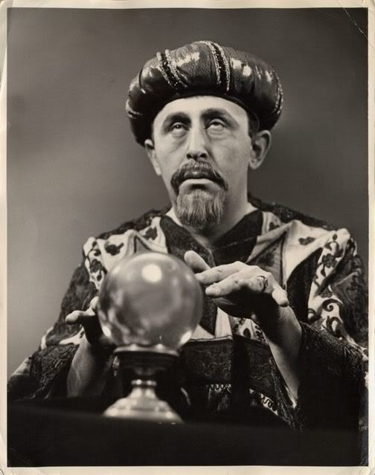
4. SOOTHSAYING
THE ART OR PRACTICE OF FORETELLING EVENTS.

Slide 31
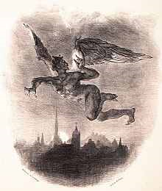
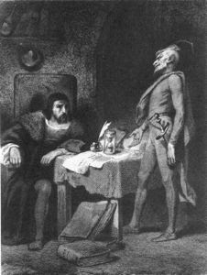
SORCERY
5. SORCERY
The use of supernatural power over others through the assistance of evil spirits.
Upper left:Mephistopheles flying over Wittenburg by Eugene Delacroix
Lower right: Faust’s Study

